Slide 1
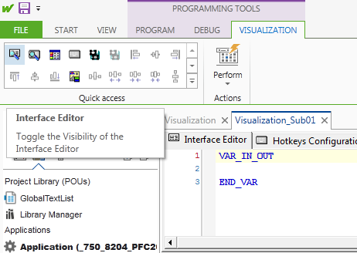
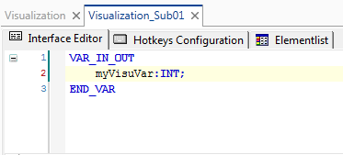
Interface Editor (using placeholders)
VAR_IN_OUT
gves Pointer
VAR_IN
copies the data
Visualization Interfaces in CODESYS 3 replacing the placeholders of CoDeSys 2.3
Go to Visualization and open the Interface Editor
(In 3s-CODESYS 3 <ALT> <F6>)
Create an SubVisu and define an IN_OUT Variable

Slide 2
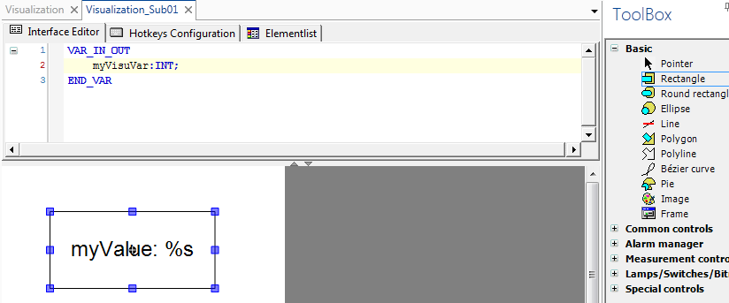
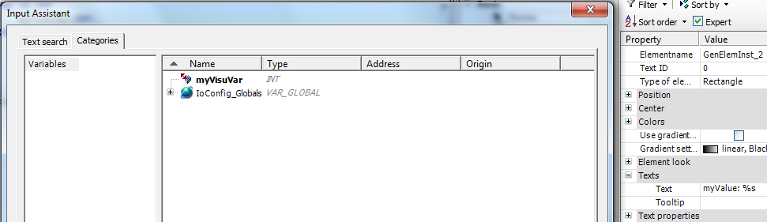
Interface Editor
Create a visu element
and select
theInterface variable
as visualization variable

Slide 3
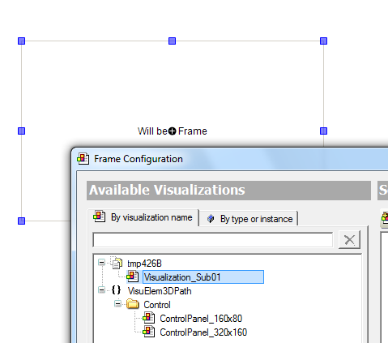
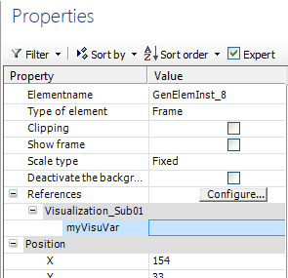
Interface Editor
Go to the main visu and call the sub visu as frame
Replace the Reference (Interface variable) with the
variable of your project

Slide 4
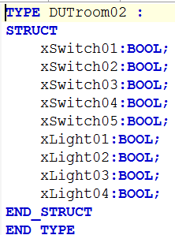
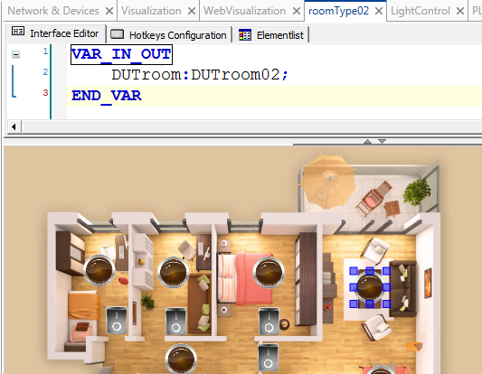
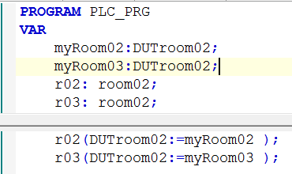
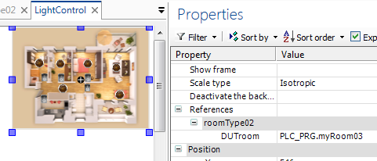
Interface Editor Example
Function Block and Visualization have got the same Data Type as IN/OUT variable.
The same type is declared in the program.
This data type variable is connected to the function block and used as visu reference.

Slide 5
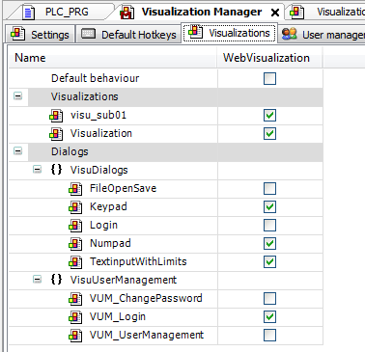
Visu User Management
Enable the Login Functionality
@ Visualization Manager/ Visualizations
To log in via webvisu the keypad must be enabled.

Slide 6
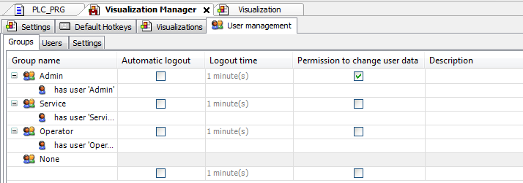
Visu User Management
Create User Groups
@ Visualization Manager/ User Management/ Groups

Slide 7
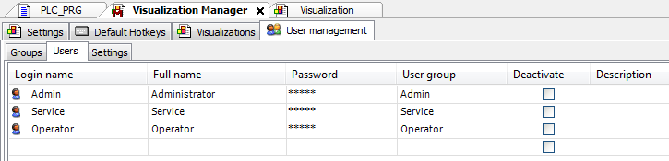
Visu User Management
Create Users and Passwords
@ Visualization Manager/ User Management/ Users
Usernames and Passwords are key sensitive

Slide 8
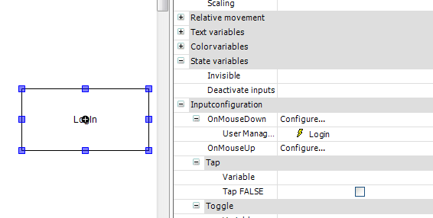
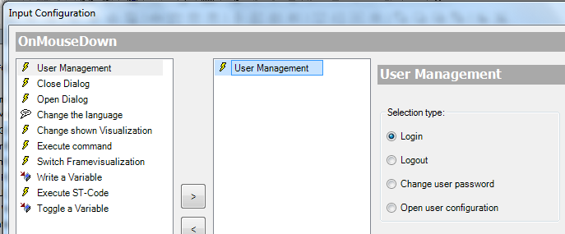
Visu User Management
Create a Log In Button
@ Inputconfiguration

Slide 9
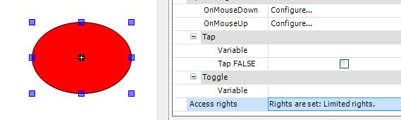
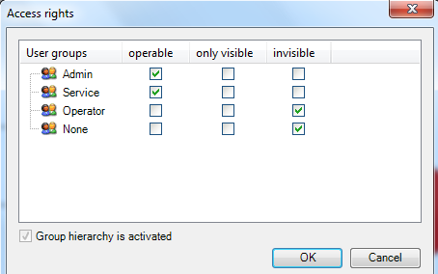
Visu User Management
Define the element properties
@ Access Rights

Slide 10
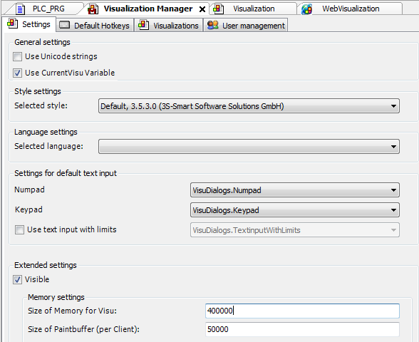
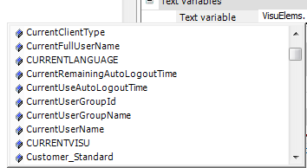
Visualization Manager
Enabling
USE CurrentVisu Variable
synchronizes different visualization clients
The Value of CurrentVisu can be read as:
VisuElems.CURRENTVISU
The pre defined type VisuElems
contains other variables too:

Slide 11
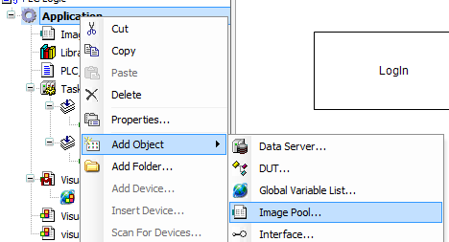
Visualization Image Pool
Bitmaps are organized in image pools within the project
To add an image pool right click on applicationand add an image pool.

Slide 12
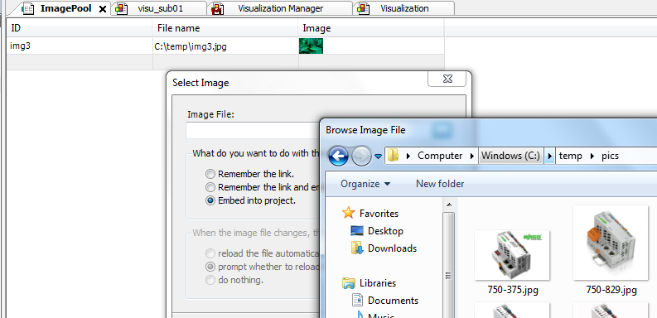
Visualization Image Pool
In the image pool you can add bitmaps

Slide 13
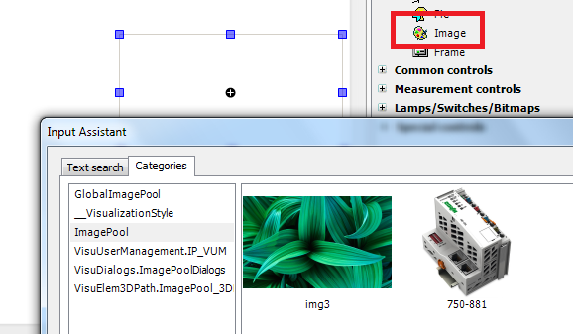
Visualization Image Pool
Now you can select the Image from the ImagePool

Slide 14
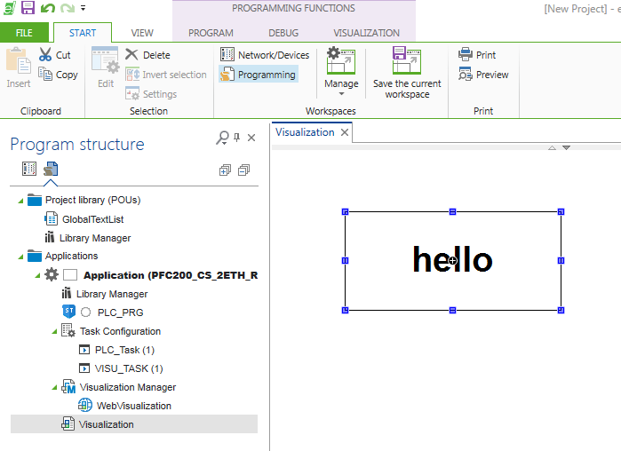
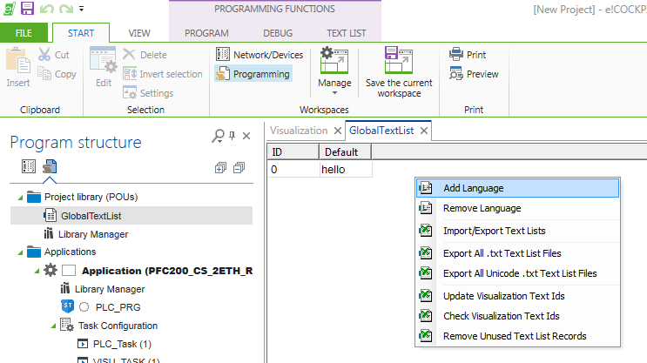
Switch Visu Language
Create a Visu Element with Text
Go to the Global Text List
at Project Library
and Add new Languages

Slide 15
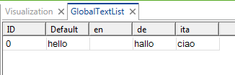
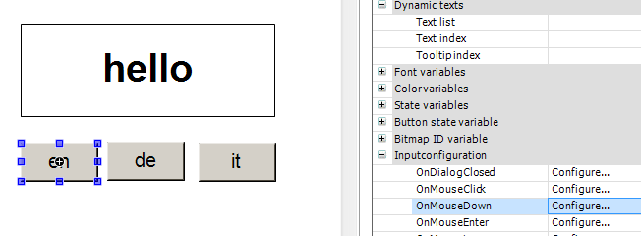
Switch Visu Language
No entry takes over the default text
To generate the language button configure the property „OnMouseDown“

Slide 16
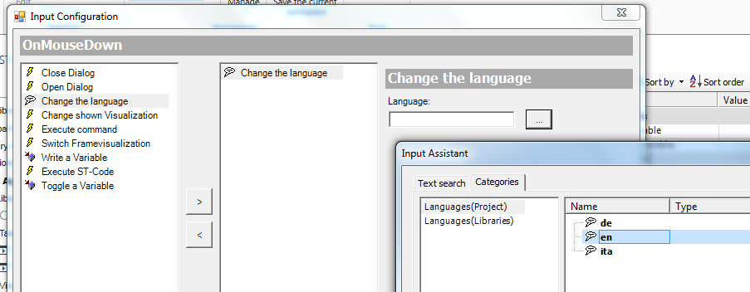
Switch Visu Language
Select Change the language and select the language to be switched to

Slide 17
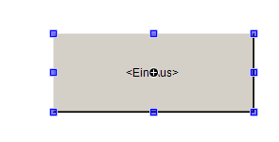
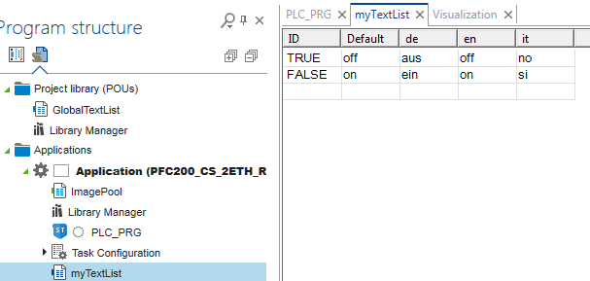
Dynamic Visu Text
Create an element with whatever text
Create a text list with replacements for the boolean values TRUE, FALSE or other data types
Caution: these values are treated as strings

Slide 18

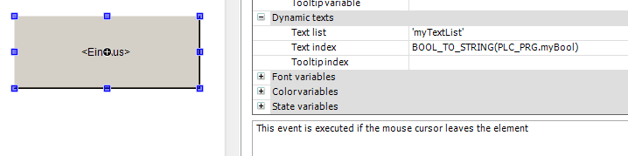
Dynamic Visu Text
Select the text list with the replacements
Do not forget the …_TO_STRING operator

Slide 19
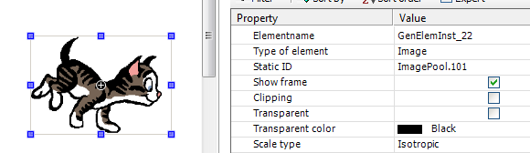
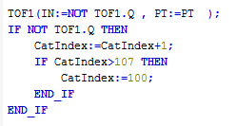

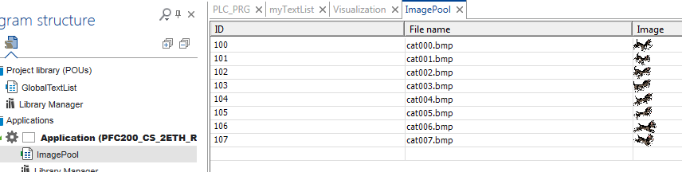
Dynamic Bitmaps

Slide 20
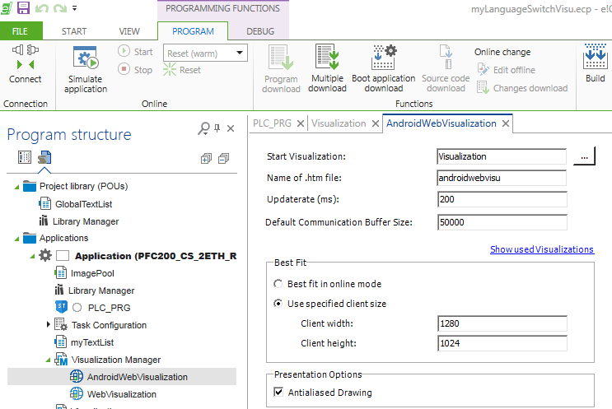
Visu Size
Additional Webvisualizations allow different settings dependeing on the visu client
(Android, IPad, PC….)

Slide 21
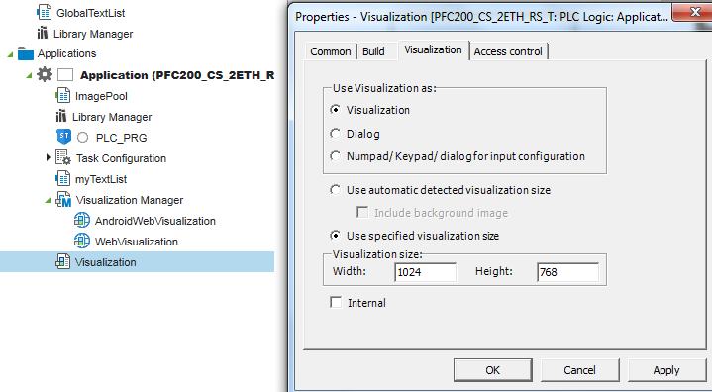
Visu Size
The paint area can be set up at Visualization Properties

Slide 22
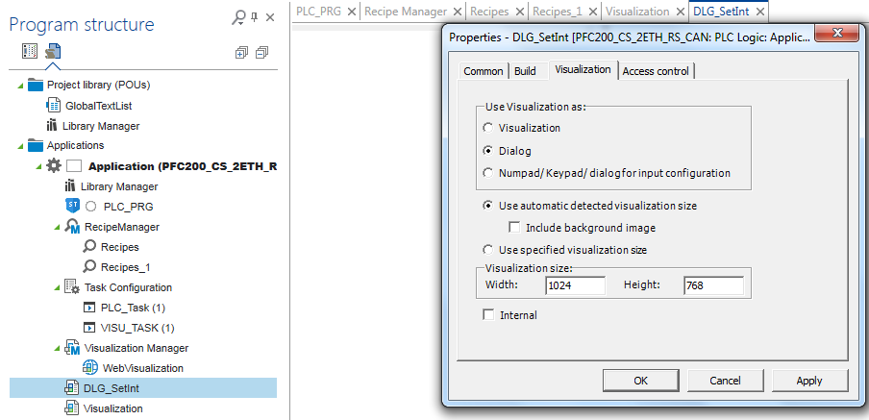
Visu Dialog

Slide 23
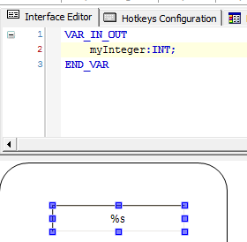
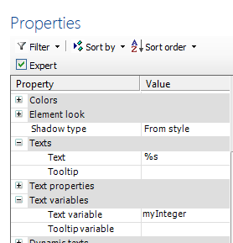
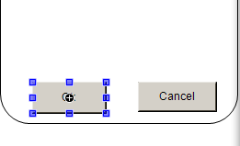
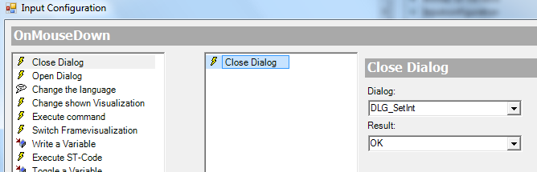
Visu Dialog

Slide 24
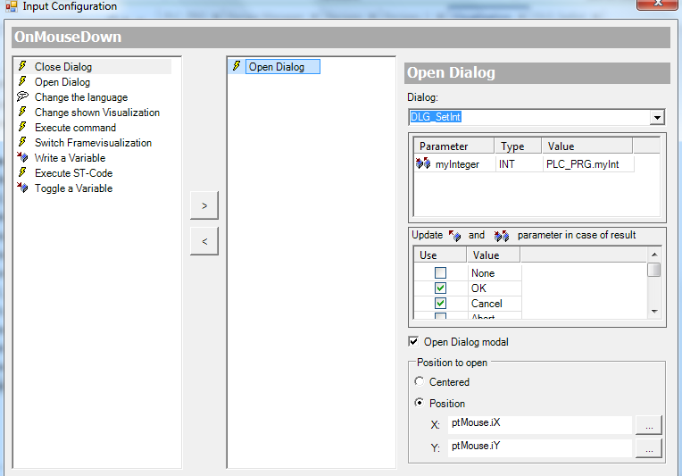
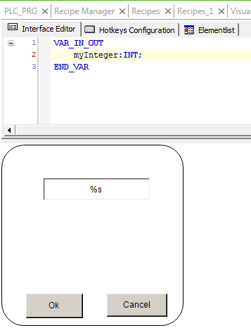
Visu Dialog

Slide 25
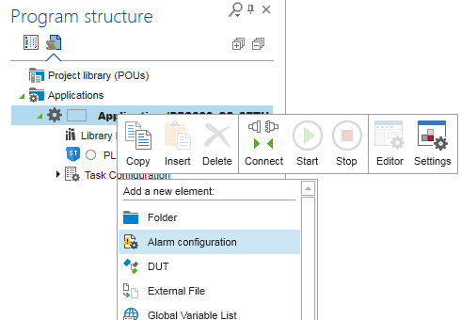
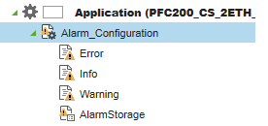
Alarm Table
Add an Alarm configuration to your project
Some default alarm classes will be automatically added

Slide 26
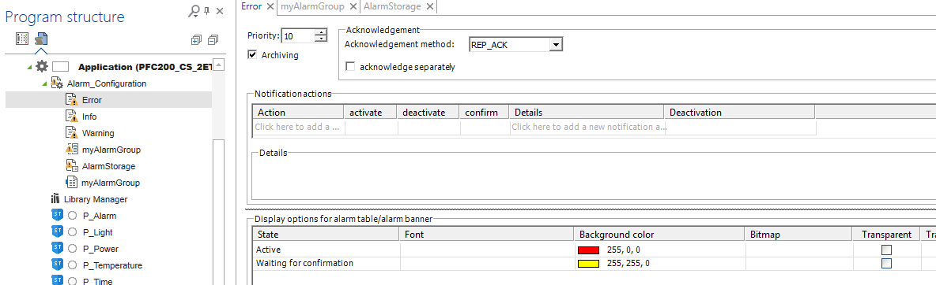
Alarm Table
You can additionally configure the Alarm class

Slide 27
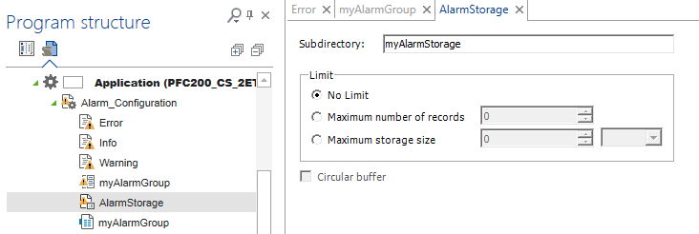
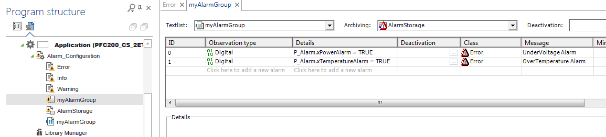
Alarm Table
Add an Alarm Storage to your Alarm configuration
Add an Alarm Group to your Alarm configuration

Slide 28
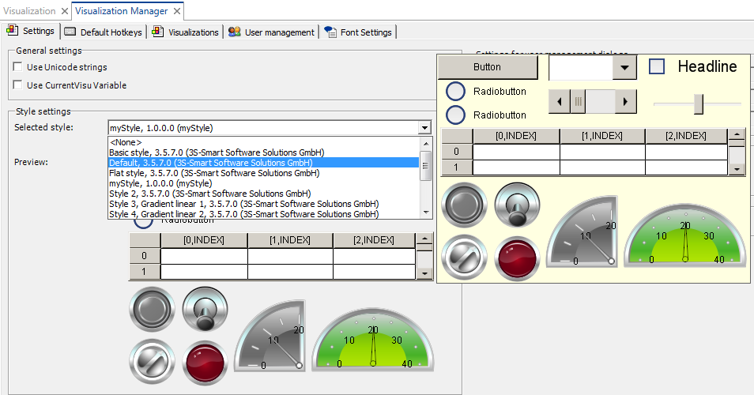
Visualization Styles
Visualization Styles can be selected and created at the Visualization Manager
To change the style of an existing visualization: generate code close visu and open itagain

Slide 29
Visualization Styles
Visualization Styles can be selected and created at the Visualization Manager
To change the style of an existing visualization: generate code close visu and open itagain

Slide 30
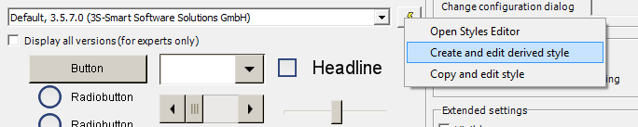
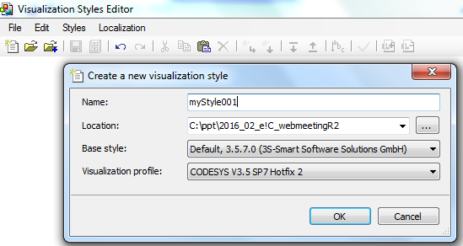
Visualization Styles
Derive an new style from an existing style
The Visualization Syles Editor opens
Save the derived style with a different name

Slide 31


Visualization Styles
Derive an new style from an existing style
Replace the existing pictures with other pictures from your harddrive.

Slide 32



Visualization Styles
Derive an new style from an existing style
Save and install the file to e!COCKPIT
Close and re-open the Visualization Manager and select the new style
Rocker Switch gray picture has changed

